Slide 1



UNDERSTANDING THE LEARNERS BRAIN DURING STRESS
Skills to help learners when they stress during the learning process.

Slide 2



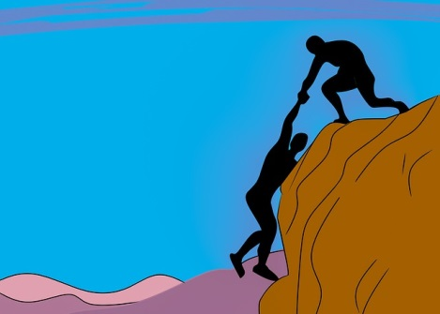





WHO?
3

Slide 3













THE INFORMATION PROCESSING SYSTEM
INPUTS
PROCESSES
OUTPUTS
4

Slide 4
Formal
Learning
No Movement
Insufficient water intake
NEURO-
STRESS
NEURO-STRESS
Illness
Polution
Excess exposure to
2D surfaces
Sleep deprivation
Malnutrition
5

Slide 5
THE INFORMATION PROCESSING SYSTEM
INPUTS
PROCESSES
OUTPUTS
6

Slide 6
THE LEFT AND RIGHT BRAIN PROCESSING
LATERAL PROCESSING
It is all about significance
7

Slide 7
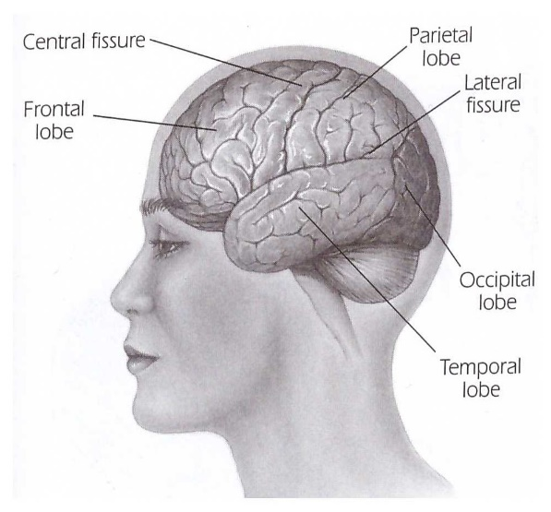
THE FRONT AND BACK BRAIN PROCESSING
EKSPRESSIVE
AND RECEPTIVE PROCESSING?
How do
I process your information
It is all about significance
8

Slide 8
THE TOP AND BOTTOM BRAIN PROCESSING
COGNITIVE AND AFFECTIVE PROCESSERING
9

Slide 9
DOWNSHIFTING
INFORMATION PROCESSING AND COMMUNICATION
10

Slide 10
HOW DOES THE LEARNER PROCESS INFORMATION?
11

Slide 11
HOW TO UNDERSTAND PERCEPTION/CONTEXT
HOW DOES THE LEARNER PROCESS INFORMATION?
12

Slide 12
TOOLS TO REDUCE THE IMPACT OF STRESS
20 min
5 min
20 min
20 min
Brain Exercises
Drink water
No sugar, caffeine or refined starch
Enough Sleep
13

Slide 13
WHY?
HOW TO KEEP THE LEARNER FOCUSSED?
WHAT?
HOW?
PLAN
14

Slide 14

MY INFORMATION
      Emilise Rautenbach
      Founder of DARE
      082 337 5412
      emilise@dare-training.com

Slide 15
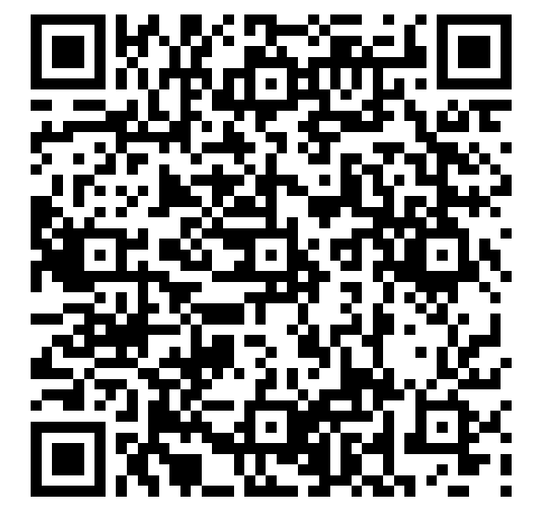
https://bit.ly/dhsfeedback1108

